Slide 1







1930 - 2014
FIFA WORLD
CUP ANALYSIS
POWER BI PROJECT
- SHAKEEB QURESHI

Slide 2

PROJECT OVERVIEW
This project offers an in-depth comprehensive examination of FIFA World Cup history, spanning tournaments from 1930 to 2014, utilizing the POWER BI tool.
The analysis is systematically divided into three major sections for thorough insights. Each section provides unique perspectives and detailed visualizations to enhance understanding of the tournament's evolution..
World Cup Stats
Matches Stats
Player Stats

Slide 3
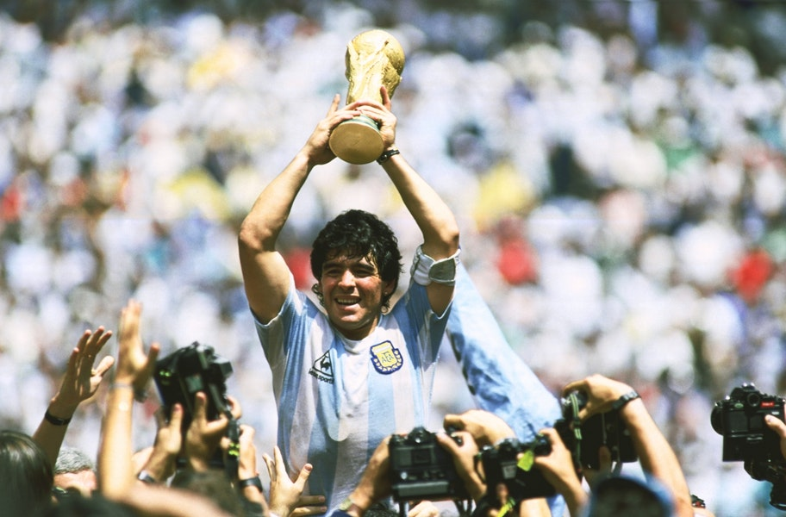

MAJOR KPIs
Total World cups
Total Matches
Total Goals Scored
20
836
2379
Most WC Wins
Most Goals (Country)
Most Goals (Player)
Brazil (5 times)
Brazil (259)
Miroslav Klose (Germany)

Slide 4


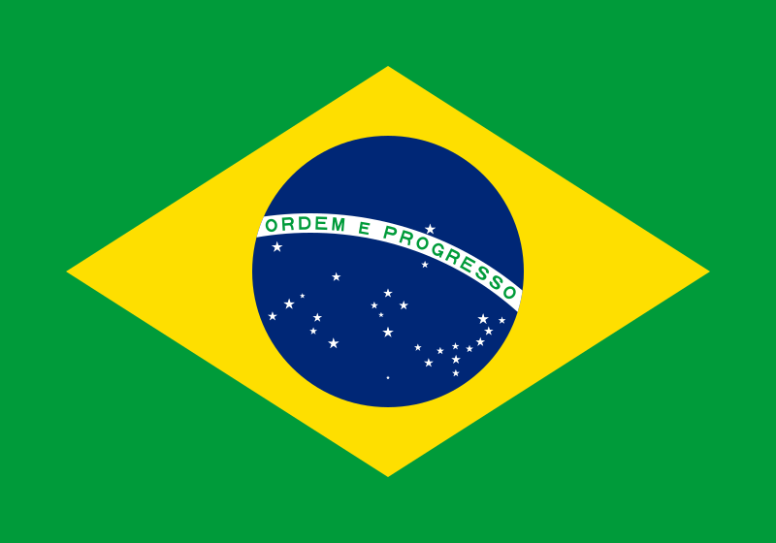






WORLD CUP WINNERS
1930
Uruguay
1962
Brazil
1986
Argentina
2010
Spain
1934
Italy
1966
England
1990
Germany
2014
Germany
1938
Italy
1970
Brazil
1994
Brazil
1950
Uruguay
1974
Germany
1998
France
1954
Germany
1978
Argentina
2002
Brazil
1958
Brazil
1982
Germany
2006
Italy

Slide 5
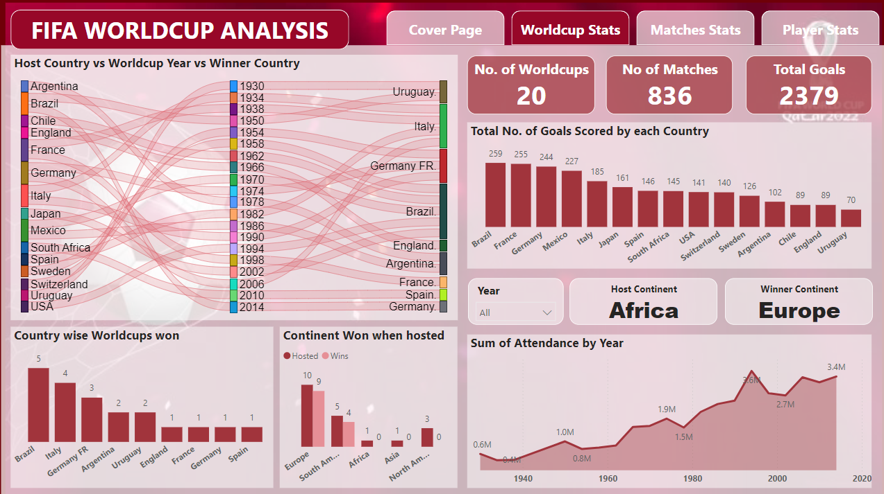
WORLD CUP STATS

Slide 6
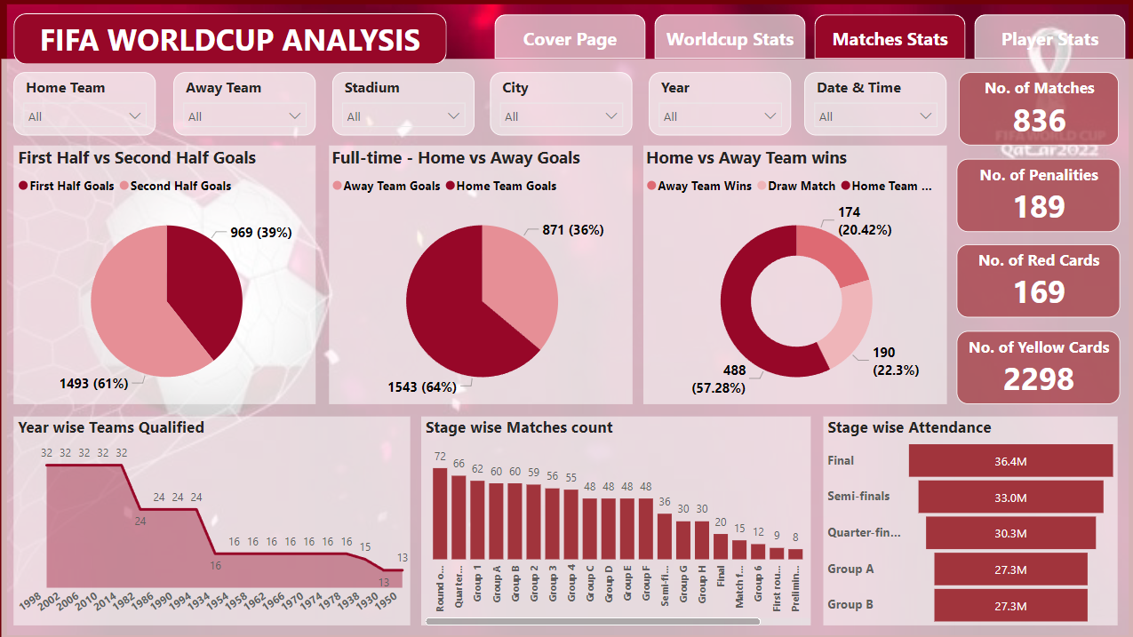
MATCHES STATS

Slide 7
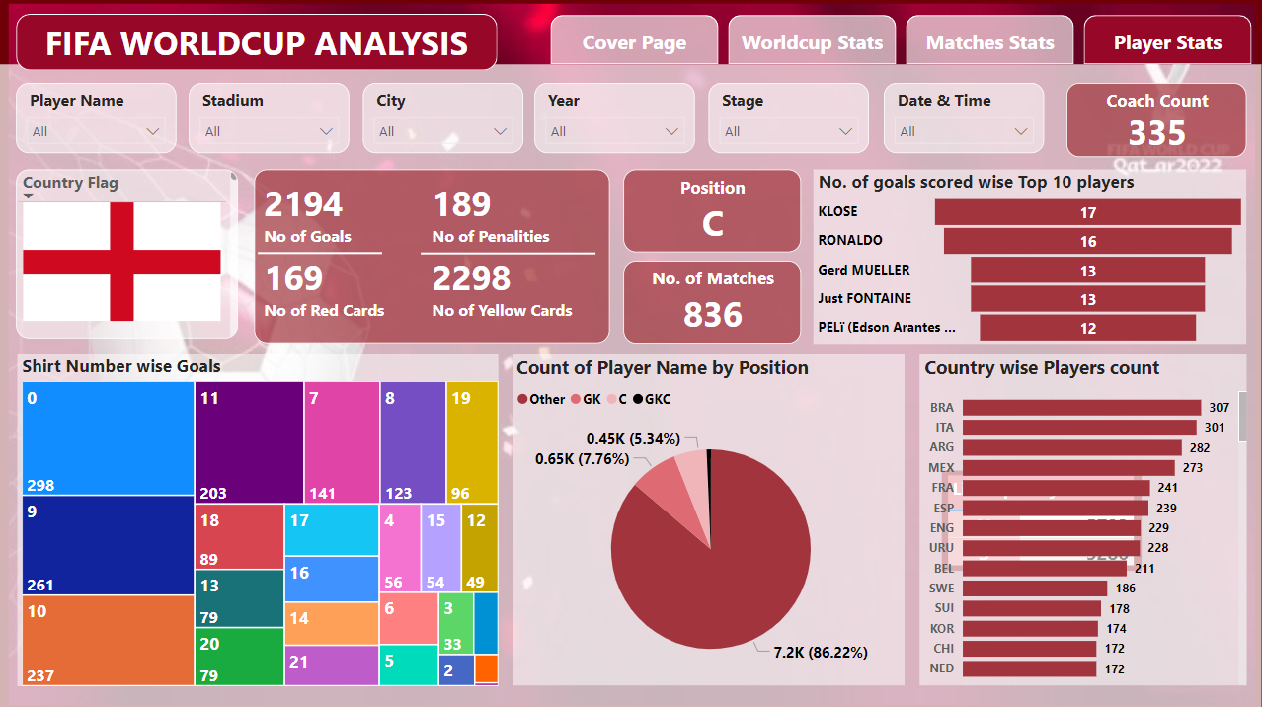
PLAYER STATS

Slide 8
THANK YOU

